Slide 1
Air Temperature and Effects on Salamander Growth Rate
Shahd Daoud, Abby Frix, Sylvia Sun

Slide 2
Table of contents
01
02
03
04
Background
Methods
Results
Conclusions

Slide 3
01
Background

Slide 4
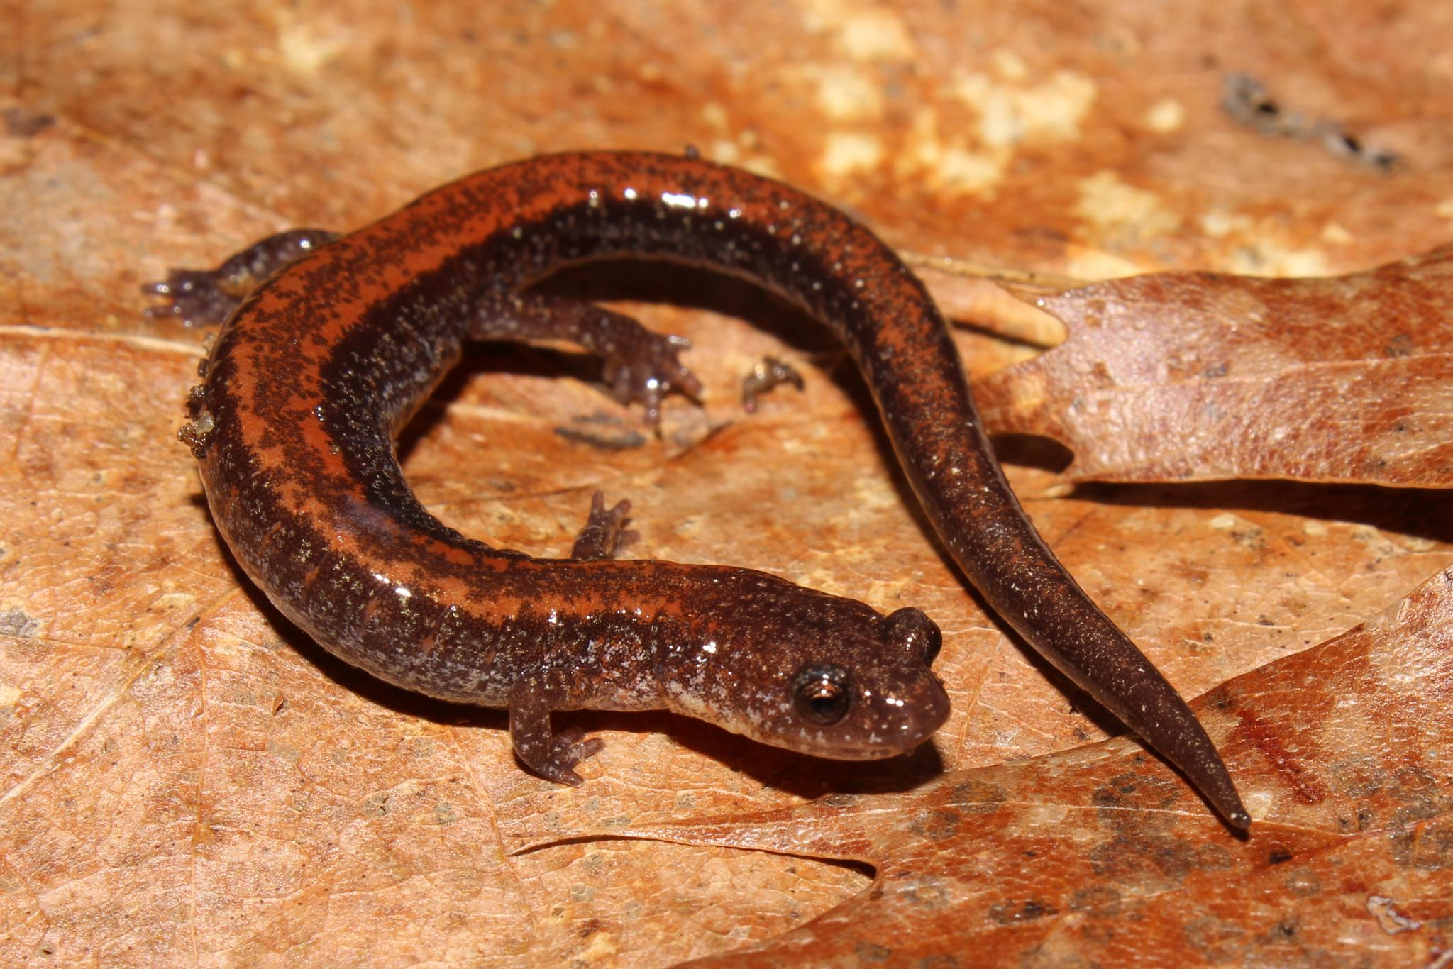
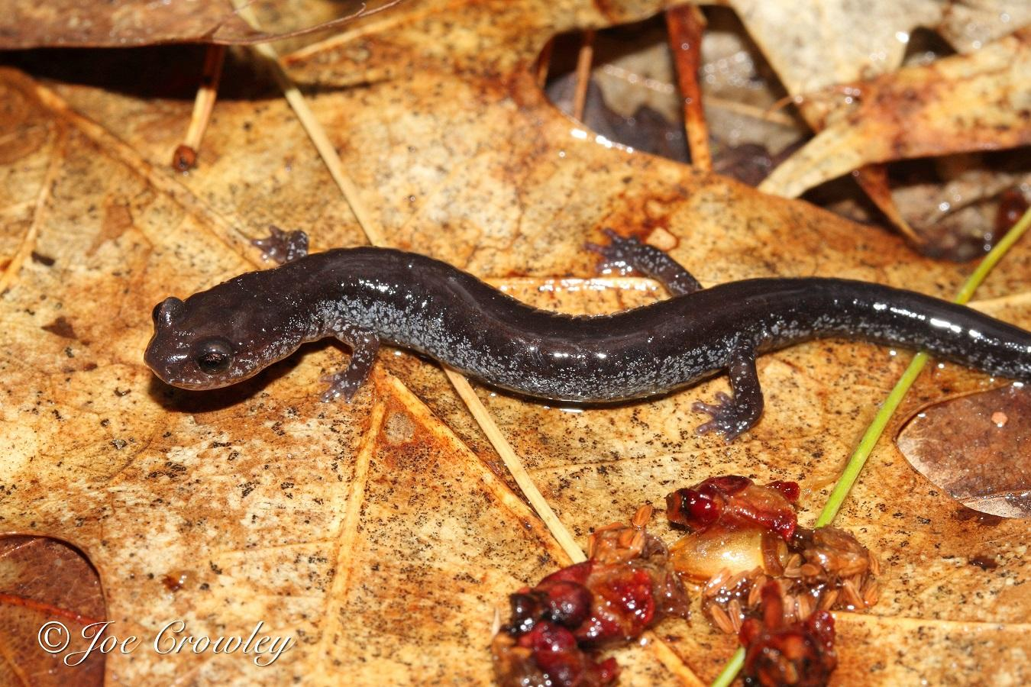
Background on Eastern Salamanders
Eastern Salamanders reside in Eastern North America¹
Habitats include moist woodlands and thrive in warmer, humid environments¹
Found in late spring to early summer (around April-July)¹
Two pattern categories: Leadback and Redback
I’m a redback morph!
I’m a leadback morph!

Slide 5

Why Study This?
Climate change is an ever impending issue
It impacts species abundance, especially aquatic organisms and their morphology changes²
Salamanders can predict future environment shifts²
Make predictions on species abundance in response to increasing temperatures
Making the goal of our model
very important!

Slide 6
Our Model
Hypothesis: That growth rates of the leadbacked morphs will be higher with increased air temperatures
Prediction: Leadbacked morphs will increase in growth rates when they are experiencing intermediate air temperatures and growth rates will decline when high temperatures are met
Dataset from the Government of Canada’s Eastern Red-backed Salamander Open Access Data
Our models consist of generalized linear models
We analyzed AICs, R-squared values, and p-values of parameter coefficients to determine the best fit model

Slide 7
02
Methods

Slide 8
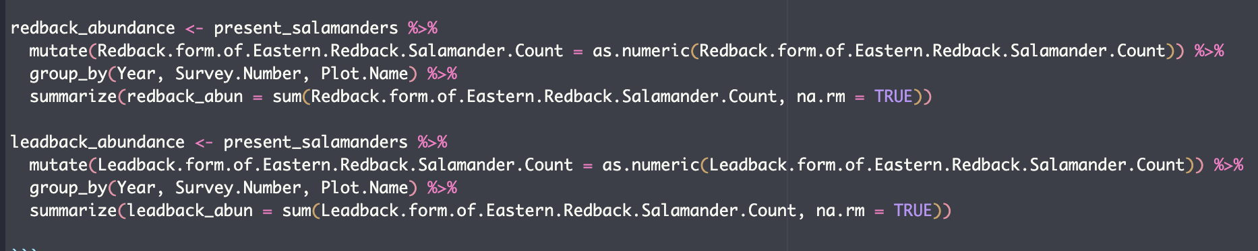
Part 1: Wrangling
Read in code
Filtered out NA values in the Leadback and Redback Salamander counts
Then, used the summarize function to group redback or leadback counts by year, survey number, and plot name and returns the sum for those variables in a new data frame

Slide 9
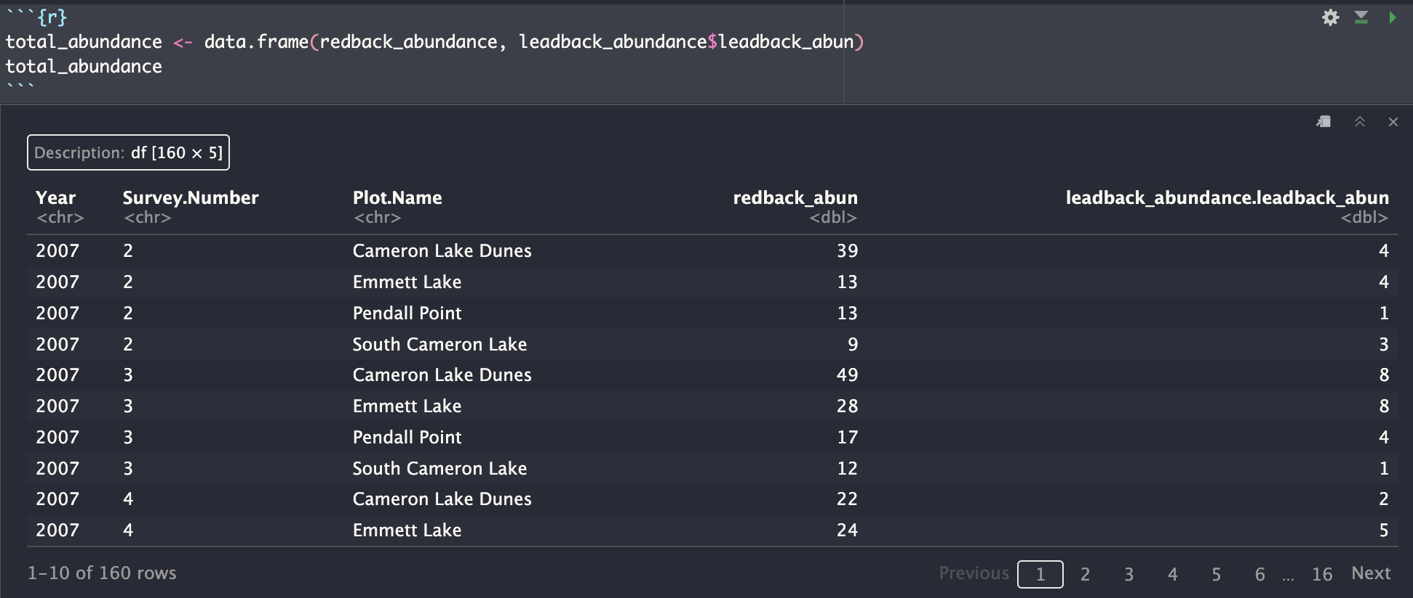
Part 1: Wrangling
Then we compiled the abundances for leadback and redback morphs into one dataframe:

Slide 10
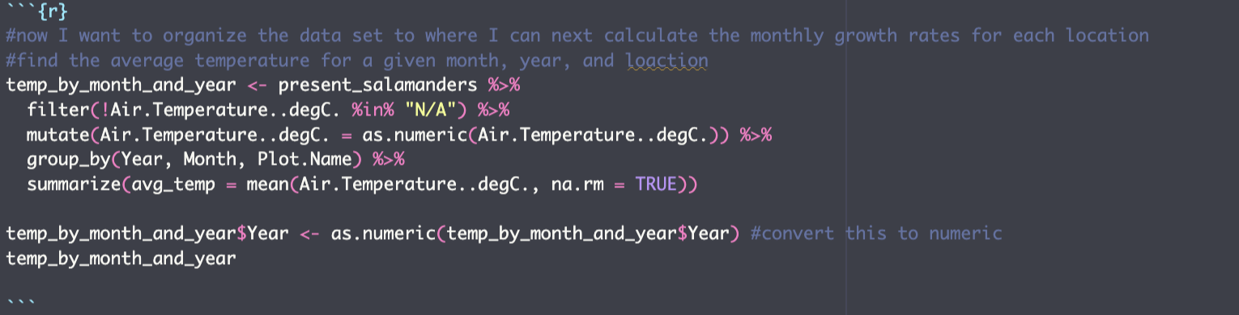
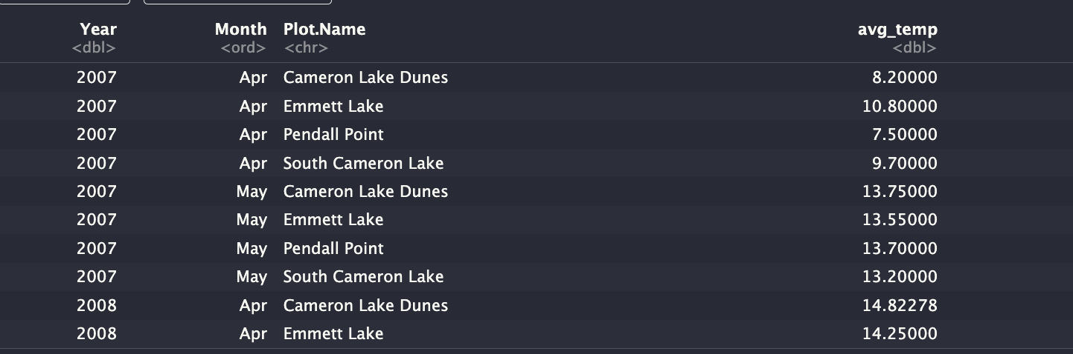
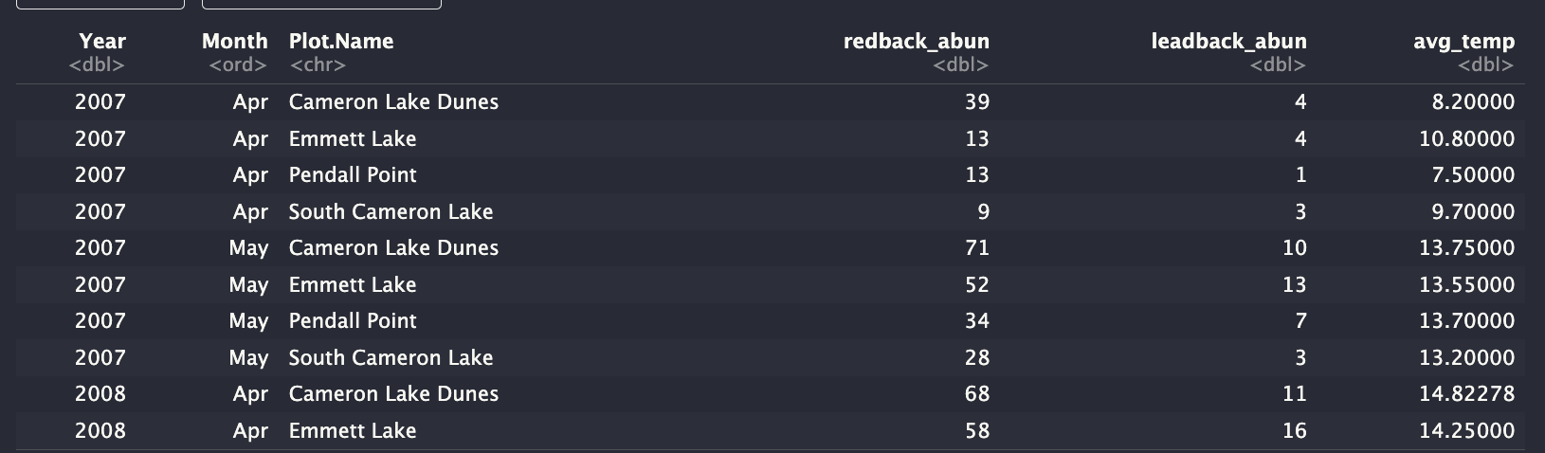
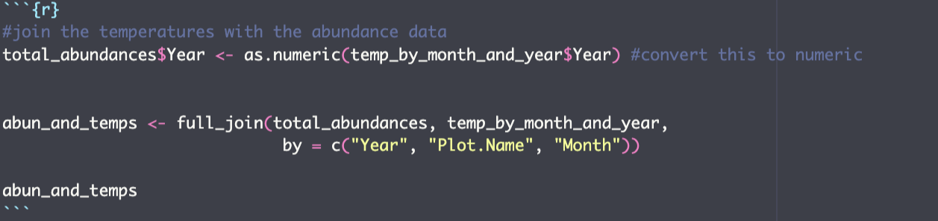
Part 1: Wrangling
Calculated average temperatures, joining the temperature data to the abundance dataframe

Slide 11
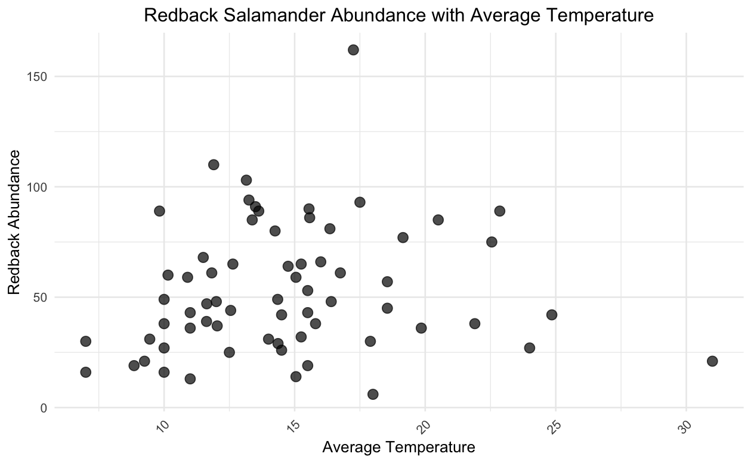
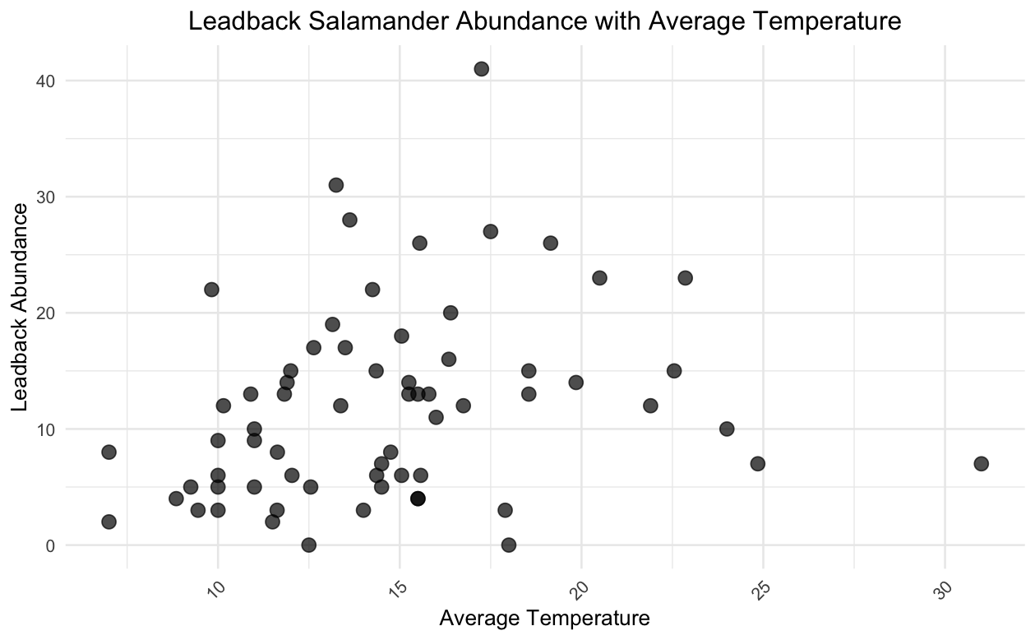
Part 2: Data Visualization
Plotted abundance and temperature data in ggplot
Observed similar positive correlation between temperature and abundance for both morphs

Slide 12

Part 3: Modeling and Selection
Step 1
Step 2
Step 3
Step 4
Fitting Linear Models
Fitting Quadratic Models
Introducing Complexity and Interaction
Model Comparison and Selection

Slide 13
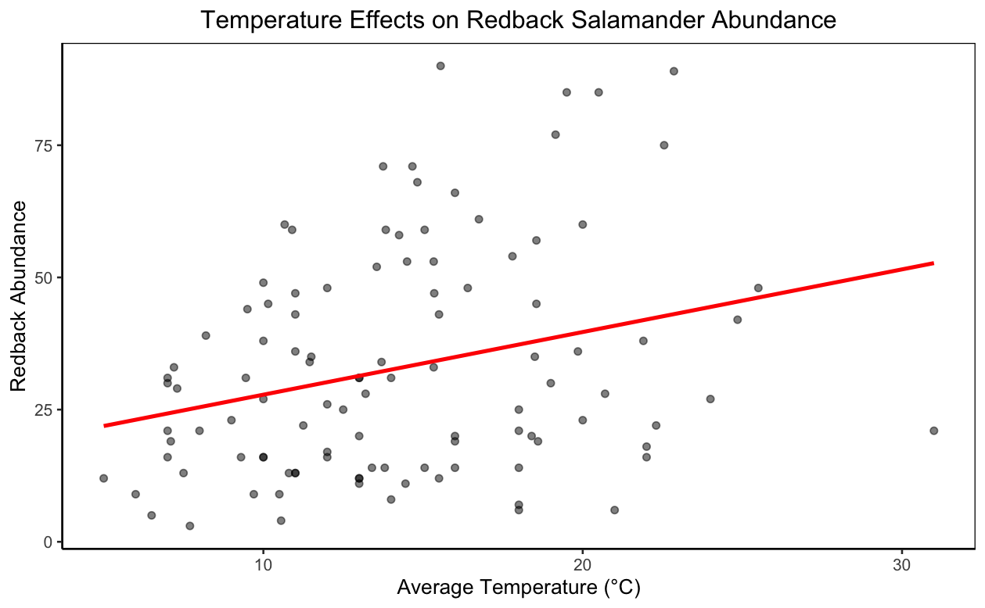
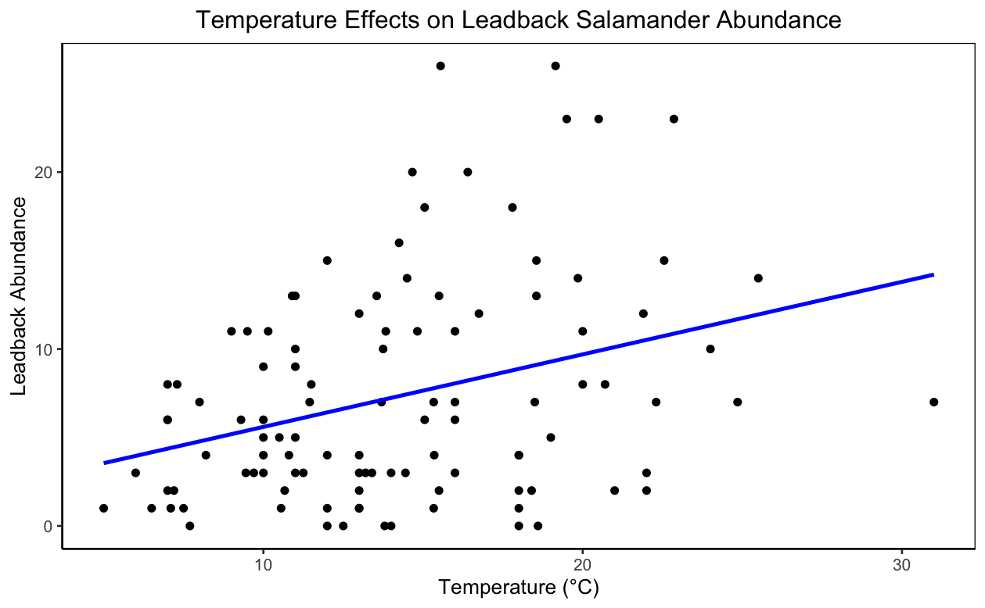
Part 3: Modeling & Selection
Fitting Linear Models to the Data

Slide 14
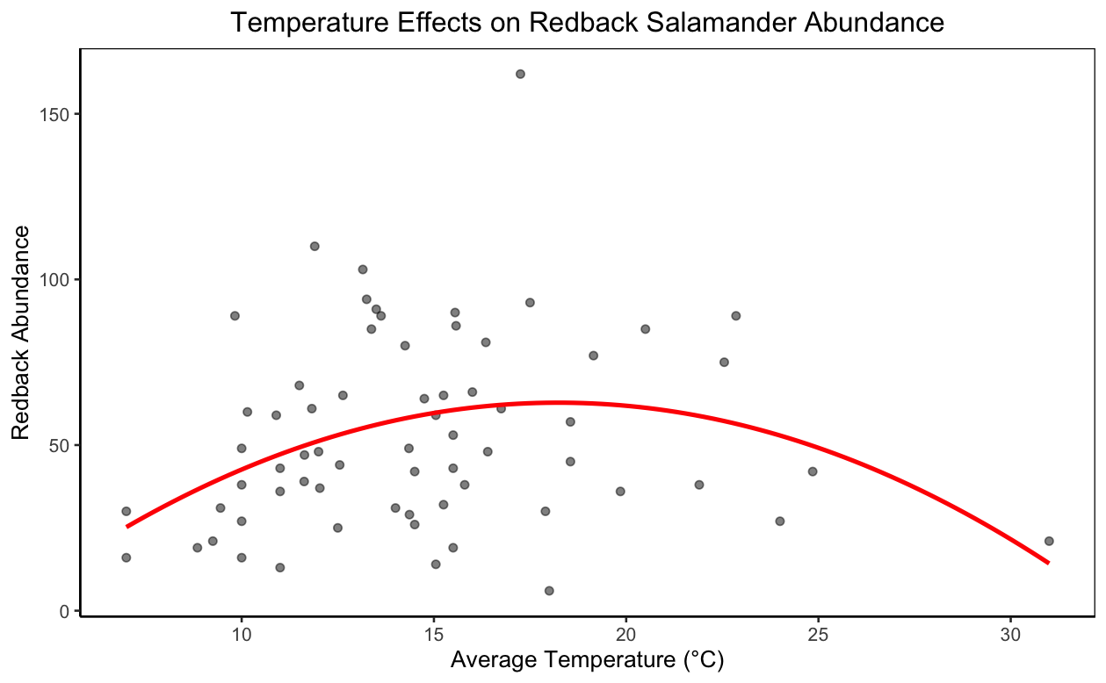
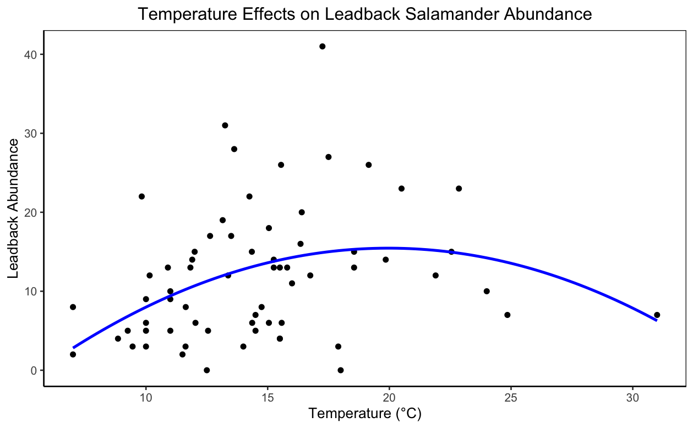
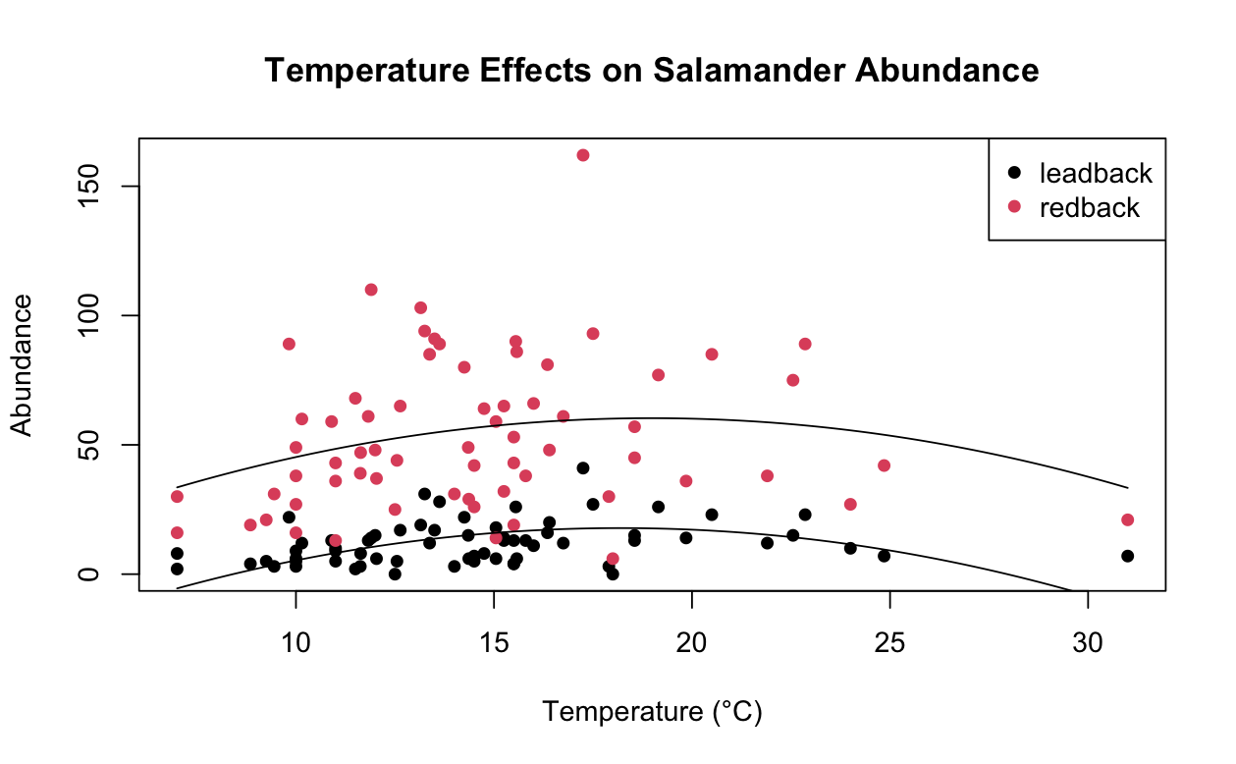
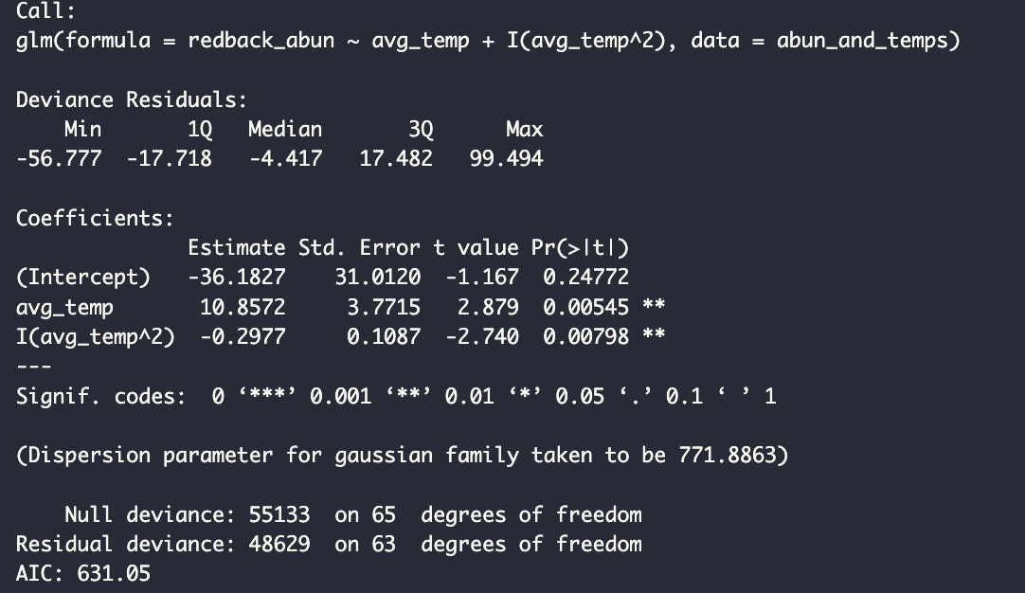
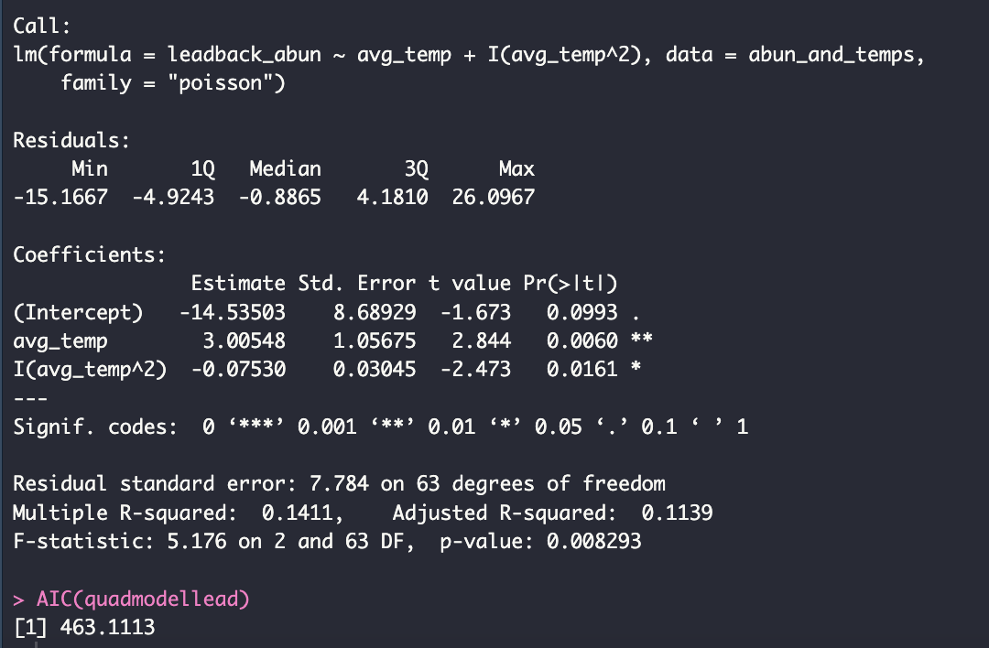
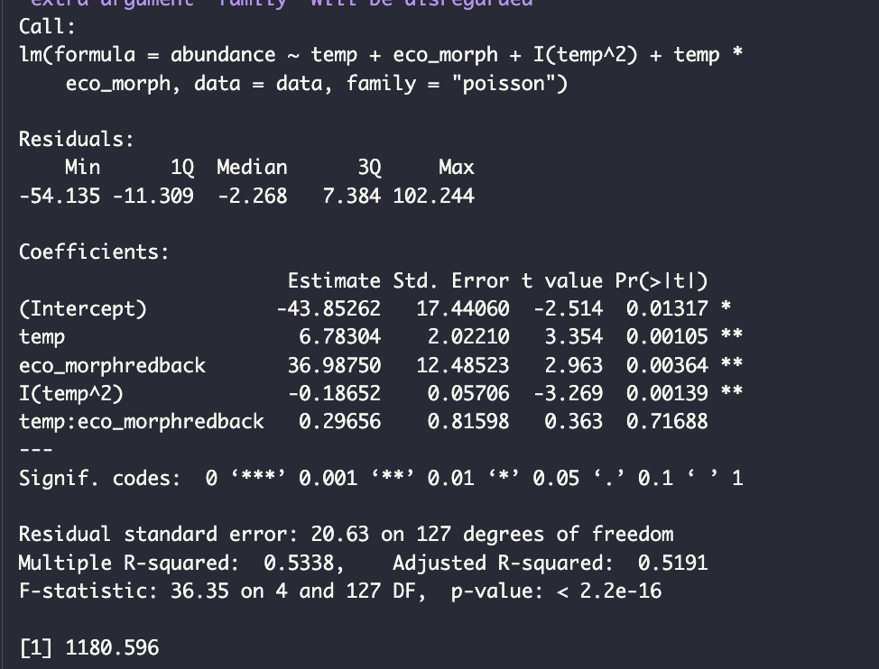
Part 3: Modeling & Selection
Redback Abundance
Leadback Abundance
Redback &
Leadback
Notes:
First analyzed the two morphs independently to see if each one followed the same patterns
Both had models of best fit with quadratic models
Then rearranged the data to where we could account for both morphs in the same model
Talk about comparing the AICs, general visualization of the models, significant coefficients for each model

Slide 15
Why this model?
Lower AIC compared to models where morphs analyzed separately
Suggests a worse fit for data? Overall, not exactly!
Higher AIC in this model could be due to increased observations/increased variation with more observations to be explained by a single model and more parameters
This model has more significant coefficients for the parameters than the previous two models, as well as a higher R squared, signaling that overall this model is superior for predicting abundance trends
Notes:
First analyzed the two morphs independently to see if each one followed the same patterns
Both had models of best fit with quadratic models
Then rearranged the data to where we could account for both morphs in the same model

Slide 16
03
Model Interpretation

Slide 17
Model Interpretation
-
Notes:
Two points could be bc of

Slide 18

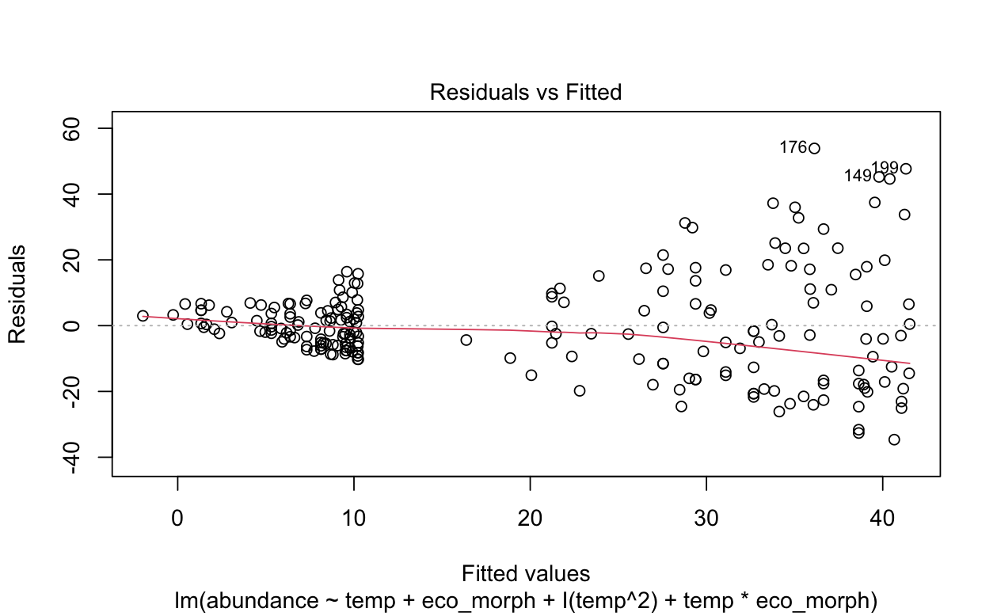
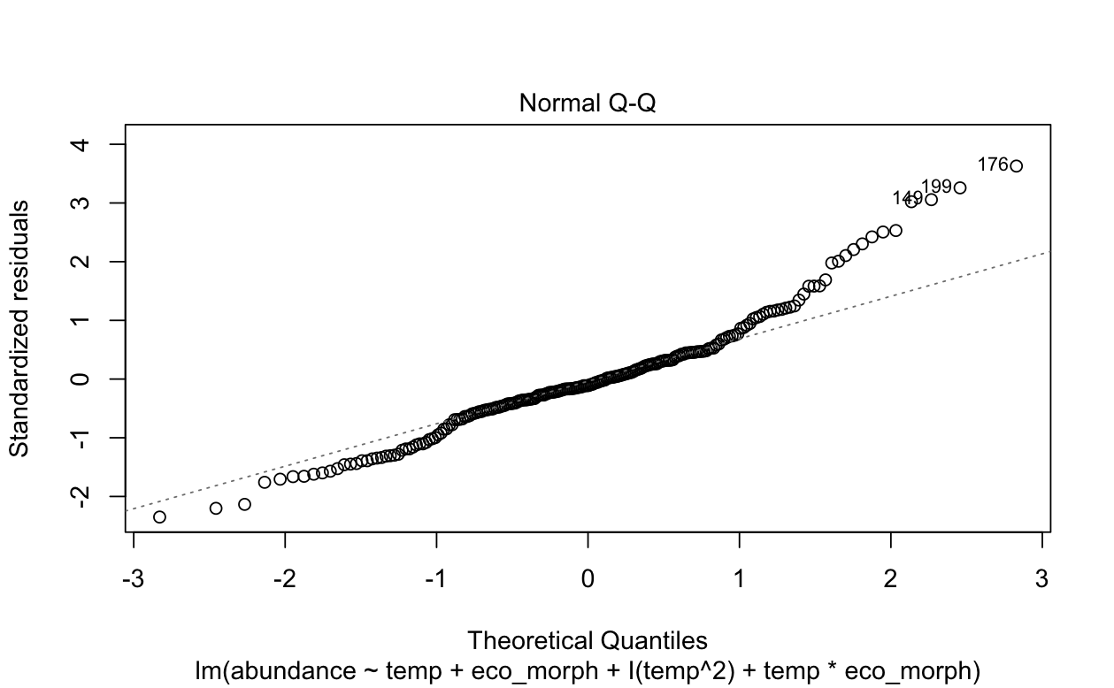
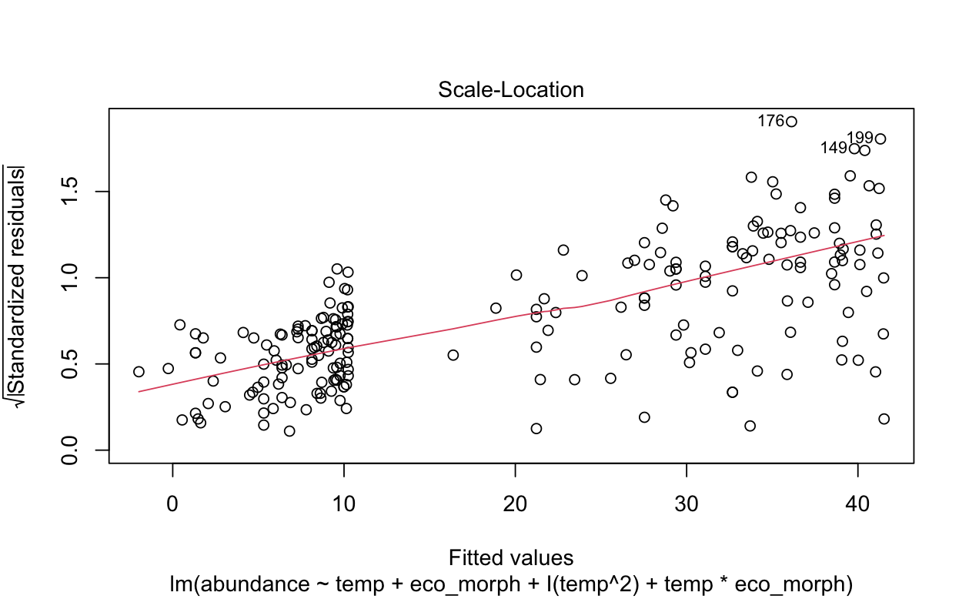
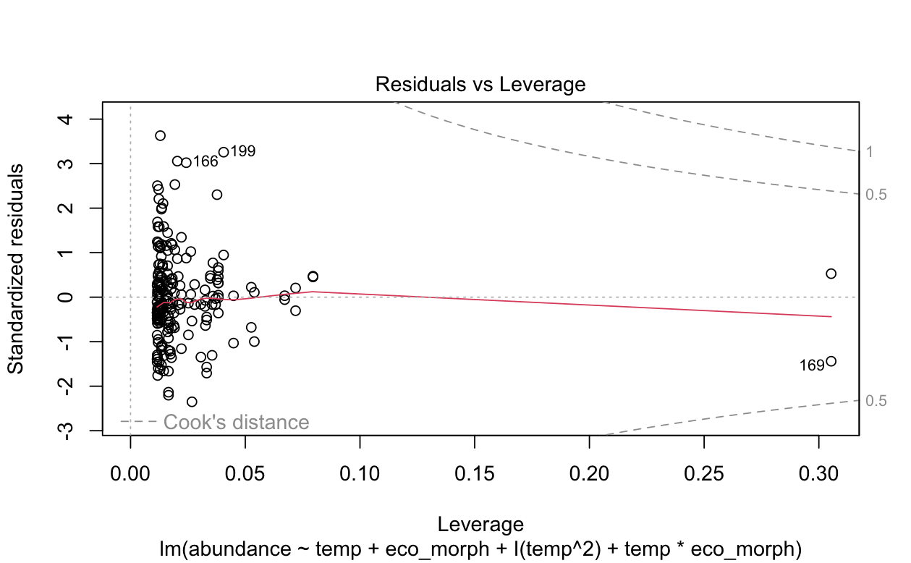
Checking the Model!!
Notes:
So the residuals vs leverage is showing us that there

Slide 19
Linearity and Homoscedasticity

Slide 20
Residual Normality

Slide 21
Influential Points
Notes:
So the residuals vs leverage is showing us that there

Slide 22
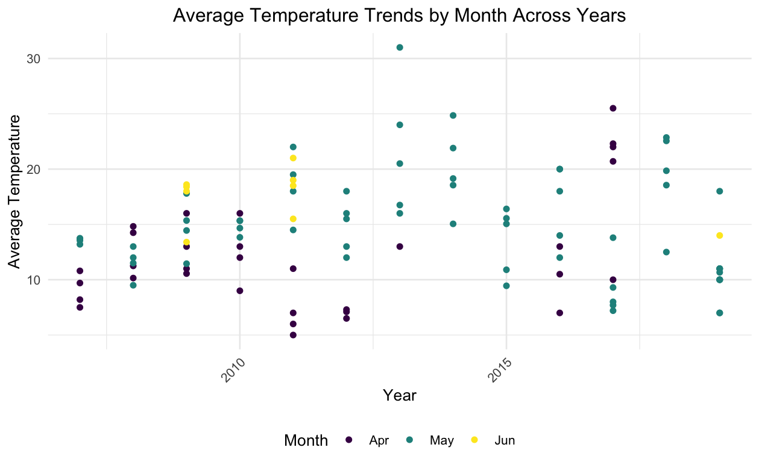
Limitations
Sampling bias in sampling period
Incomplete dataset
Higher temperatures have some noted abundances, but not all!
Some random timepoints across the sampled time were missing

Slide 23
04
Next Steps

Slide 24

Next Steps
Using our models to determine potential relationships between salamander growth rates with precipitation and soil moisture
Predictive modelling of future growth rates
Potential simulation studies after manipulating variables to identify abundance changes in response to manipulated variables
Notes:
First analyzed the two morphs independently to see if each one followed the same patterns
Both had models of best fit with quadratic models
Then rearranged the data to where we could account for both morphs in the same model

Slide 25
References
Canadian Herpetological Society [Internet]. [cited 2024 Dec 3]. Available from: https://canadianherpetology.ca/species/species_page.html?cname=Eastern%20Red-backed%20Salamander
Ficetola GF, Colleoni E, Renaud J, Scali S, Padoa-Schioppa E, Thuiller W. Morphological variation in salamanders and their potential response to climate change. Glob Chang Biol. 2016 Jun;22(6):2013–24.

